Slide 1
Text Classification Using Neural Networks and the Word2Vec Methodology
John Juele
Computer Systems (LM051)
Supervisor: Farshad Toosi

Slide 2
Objective
“The statue was created by Donatello in the year…”
“History”
Text Input
System
Subject/Topic
Notes:
Software system to process text and to output subject/topic/tag that would best describe the input text
BASE GOAL
Just a milestone
Possibility of other paths and implement a more specific function

Slide 3
Project Environment/Materials
Programming Language
Python
Development Environments
PyCharm
Libraries/Frameworks
TensorFlow
Gensim
Scikit-Learn
NumPy
Matplotlib
SciPy

Slide 4
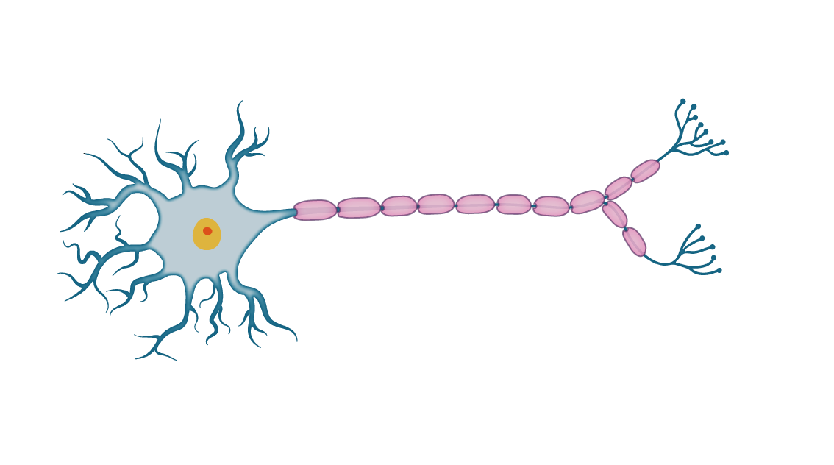
Neuron
Cell Body
Axon
Nucleus
Dendrites

Slide 5



Neural Network Architecture
$$w_{1,1}$$
$$w_{2,1}$$
$$w_{3,1}$$
Input
Hidden
Output

Slide 6
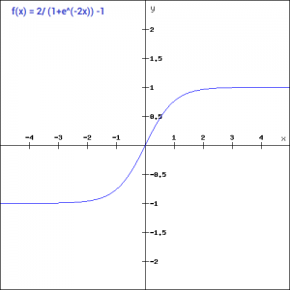
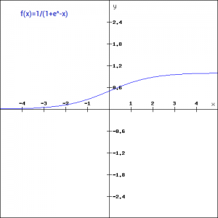
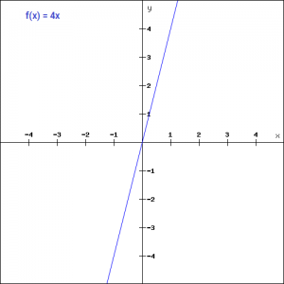

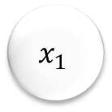
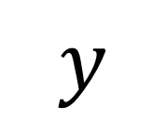
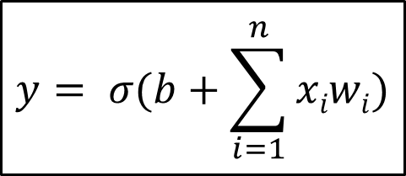









Artificial Neuron
$$x_{1}$$
$$w_{1}$$
$$w_{2}$$
$$Σ$$
$$f\left(x\right)$$
$$y$$
$$x_{2}$$
$$w_{3}$$
$$x_{3}$$
$$y= σ(b+\sum_{i=1}^{n}{xiwi)}$$
$$b$$
$$x_{1}w_{1}+x_{2}w_{2}+x_{3}w_{3}$$
$$+b$$
“Activation”

Slide 7
Feed-Forward Algorithm
3
1.23
0.8
0.5
-3.2
-1.1
0.99
1
0.17
-2.3
3.4
-0.54
1
-0.33
0.03
Input
Hidden
Output

Slide 8








Training the Neural Network
$$E1$$
$$E1$$
3
0.8
$$Error=answer−guess$$
$$E2$$
$$Eoutput$$
$$Eoutput=1−0.17=0.83$$
0.99
0.17
$$E2$$
$E$₃
1
0.02
Back-Propagation

Slide 9


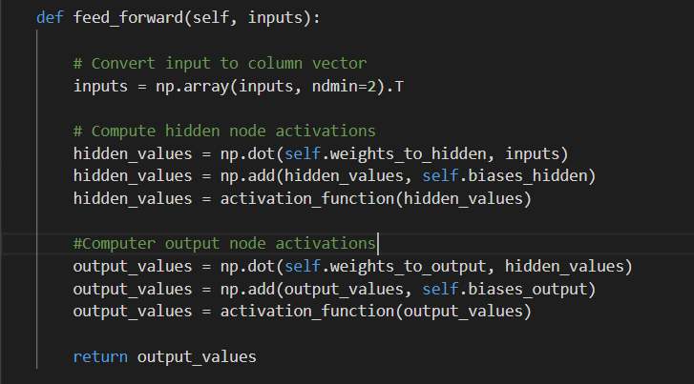
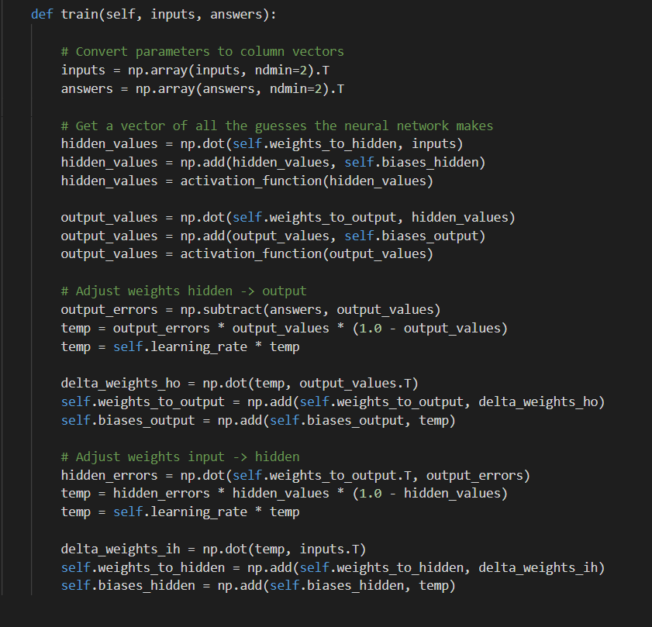
My Neural Network Implementation

Slide 10
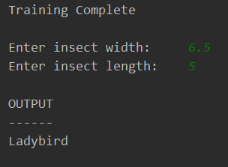
My NN Implementation
?

Slide 11
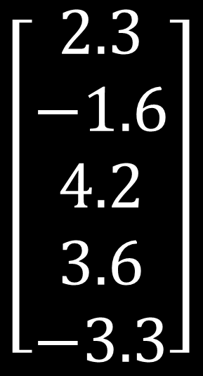
Word2Vec
Produces word embeddings
Maintains word semantics
$$\left[\begin{aligned}2.3 \\ −1.6 \\ 4.2 \\ 3.6 \\ −3.3\end{aligned}\right]$$
“COMPUTER”
Types:
Continuous Bag of Words
Skip-gram
Notes:
Purpose of word embeddings?
Help computer understand the word
Easily processing and manipulation

Slide 12
How Does It Work?
“Computer”
0
0
0
0
1
0
0
0
0
0.98
0.4
0.03
0.86
0.45
0.12
0.32
0.54
0.64
“Monitor”
2.3
-1.6
4.2
3.6
-3.3
“Keyboard”
Input
Hidden
Output

Slide 13


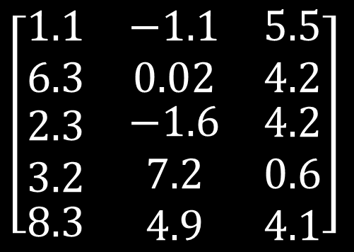



Getting the Word Vector
$$\left[\begin{matrix}1.1 & −1.1 & 5.5 \\ 6.3 & 0.02 & 4.2 \\ \begin{aligned}\begin{aligned}2.3 \\ 3.2\end{aligned} \\ 8.3\end{aligned} & \begin{aligned}−1.6 \\ 7.2 \\ 4.9\end{aligned} & \begin{aligned}4.2 \\ 0.6 \\ 4.1\end{aligned}\end{matrix}\right]$$
“COMPUTER”
$$\left[0 0 1 0 0\right]$$
$$=$$
$$\left[2.3 −1.6 4.2\right]$$
“COMPUTER”
$$\left[2.3 −1.6 4.2\right]$$
$$=$$

Slide 14
Offensive Language Identification / Cyber Bullying
Scientific Paper Tagging
News Article Tagging
Text Classification
Sentence Auto-Complete
Spam Identification
Emergency Detection on Social Media
Sentimental Analysis

Slide 15
Project Plan
Semester 1
Semester 2
Find appropriate datasets
Do more research
Plan/Commence implementation
Complete implementation
Testing
Search for / apply improvements

Slide 16
References
Neural Networks
Rashid, T. (2016) Make Your Own Neural Network: A gentle journey through the mathematics of neural networks, making your own using the Python computer language, 1st ed., Germany: Amazon Distribution
3Blue1Brown (2017) “But what *is* a Neural Network? | Deep learning, chapter 1”, Neural Networks [video], available:
https://www.youtube.com/watch?v=aircAruvnKk&t=958s&list=PLZHQObOWTQDNU6R1_67000Dx_ZCJB-3pi&index=2 [accessed 17 Sep 2018]
Nielsen, M. A. (2015) Neural Networks and Deep Learning, Determination Press, available:
http://neuralnetworksanddeeplearning.com/index.html [accessed 18 Sep 2018]
How To Build Your Own Neural Network From Scratch (n.d) Towards Data Science, available:
https://towardsdatascience.com/how-to-build-your-own-neural-network-from-scratch-in-python-68998a08e4f6 [accessed 20 Sep 2018]

Slide 17
Word2Vec
McCormick, C. (2016) Word2Vec Tutorial – The Skip-gram Model, available:
http://mccormickml.com/2016/04/19/word2vec-tutorial-the-skip-gram-model/ [accessed 5 Oct 2018]
Macheads101 (2017) Word Embeddings [video] available:
https://www.youtube.com/watch?v=5PL0TmQhItY&t=707s [accessed 5 Oct 2018]
Tamir, M. (2016) A Short Introduction to Using Word2Vec for Text Classification, LinkedIn, available:
https://www.linkedin.com/pulse/short-introduction-using-word2vec-text-classification-mike/ [accessed 9 Oct 2018]
Drozd, N. (2016) Text Classification With Word2Vec, DS Lore: words about stuff, 20 May, available:
http://nadbordrozd.github.io/blog/2016/05/20/text-classification-with-word2vec/ [accessed 9 Oct 2018]

